Slide 1
Functional Connectivity: The Principal-Component Analysis of Large (PET) Data Sets
by
K. J. Friston, C. D. Frith, P. F. Liddle, and R. S. J. Frackowiak

Slide 2
Summary:
The distributed brain systems associated with performance of a verbal fluency task were identified in a nondirected correlational analysis of neurophysiological data obtained with positron tomography. This analysis used a recursive principal-component analysis developed specifically for large data sets. This analysis is interpreted in terms of functional connectivity, defined as the temporal correlation of a neurophysiological index measured in different brain areas. The results suggest that the variance in neurophysiological measurements, introduced experimentally , was accounted for by two independent principal components. The first, and considerably larger, highlighted an intentional brain system seen in previous studies of verbal fluency. The second identified a distributed brain system including the anterior cingulate and Wernicke's area that reflected monotonic time effects. We propose that this system has an attentional bias. Key Words: PET-Principal-component analysis-Functional connectivity-Effective connectivity-Verbal fluencyNeural networks.

Slide 3
FUNCTIONAL AND EFFECTIVE CONNECTIVITY
In the past two decades, the concept of functional or effective connectivity has been most thoroughly elaborated in the analysis of multiunit recordings of separable neuronal spike trains, recorded simultaneously from different brain areas (Gerstein and Perkel, 1969; Gerstein et aI., 1989). Temporal coherence among the activity of different neurones is commonly measured by cross-correlating their spike trains. The resulting correlograms are then interpreted as the signature of functional connectivity. In current approaches, effective connectivity is of the correlation matrix in terms of principal components or eigenvectors. These vectors are the linear combinations that account for independent or orthogonal amounts of variance in the observed data. Only a few principal components are usually required to explain the majority of observed variance. In terms of functional connectivity, a principal component represents a truly distributed brain system within which there are high intercorrelations. Furthermore, because any one component is orthogonal to the remaining, these systems are functionally unconnected from each other. However, any single area may be implicated in more than one system.

Slide 4
METHODS
Recursive PCA Analysis The technique is modeled on "L" systems or string rewriting systems used in the construction of fractal and self similar patterns. L systems were introduced by Linenmayer in 1968 to model the growth of living organisms. In these systems, a pattern (axiom) is defined that is composed of line segments. According to (production) rules, each segment is replaced by the pattern primitive. This primitive is itself constructed from line segments that are recursively replaced with smaller scaled primitives. No "drawing" actually occurs until the scale reaches a specified lower limit [see Voss (1988) for a full discussion]. The charm of these systems is that the algorithm that replaces each line segment of the primitive with smaller versions calls itself recursively but only implements pattern drawing at the smallest scale. In a similar way, the recursive peA used here recursively calls itself until the size of subpartitions of the original data matrix reach a lower limit. Let e(M) denote the operation of the

Slide 5
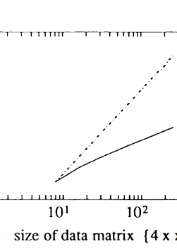
FIG. 1. Regression of number of floating point operations on size x of data matrix {4, x} for normal (nonrecursive) PCA (broken line) and recursive PCA (solid line). This regression is plotted in log space. ical. This is seen in Fig. 2, which is a regression (in log space) of the number of floating point operations required on the size of the data matrix. In practice, the PCA takes about 14 s for a {6,2048} data matrix on a contemporary (SP ARC) workstation. See Moler et al. (1987) and Smith et al. (1976) for a description of the eigenvector solution (E{'}) implemented when the stopping criterion is reached. We have presented an algorithm that uses bisection of M. This requires the number of columns to be a multiple of 2. More elaborate schemes are possible using noway splits.

Slide 6
FUNCTIONAL CONNECTIVITY
PCA operator eo on a data matrix M where M can be bisected (M = [MIM2]). The algorithm is defined by the following equivalence (where' denotes matrix multiplication): until the size of M reaches a lower limit (S); then, e{M} = E{C{M}} = Qk (3) where Qk are the largest S/2 eigenvectors of the covariance matrix of M ( = C{M}). The operator eo recursively calls itself until the multiply bisected subpartitions reach a stopping criterion in terms of size (S). The recursion relationship (2) essentially implies the splitting of a data matrix, the rotation of the observed scores of each half into principal component (PC) scores and the elimination of the half of these (redundant) scores before computing the eigenvectors of C{M}. The eigenvector solution is obtained by postmultiplying the original transformation matrix with the eigenvectors of the rotated and reduced data matrix. This elimination or reduction means that the largest matrix actually operated on by e{·} never exceeds size S. This holds for any size of M. The justification for eliminating half of the PC scores [implicit in Eq. (3)] relates to the sample size to dimensionality ratio. The subspace spanned by the data can only be an (n - I)-dimensional subspace of the S-dimensional space defined by the PCs. In other words, the PC scores, although S in number, only describe variance in the n - 1 «S/2) eigenvectors with nonzero eigenvalues. The rest, being zero, can be eliminated with no loss of information. The algorithm used is provided in PRO-MATLAB in Table 1 and a worked example is given in the Appendix. The saving in terms of computational overhead is illustrated in Fig. 1. As the size of M increases, the number of computational steps in a normal PCA increases geometrically. For the recursive approach, these increments are more arithmet

Slide 7
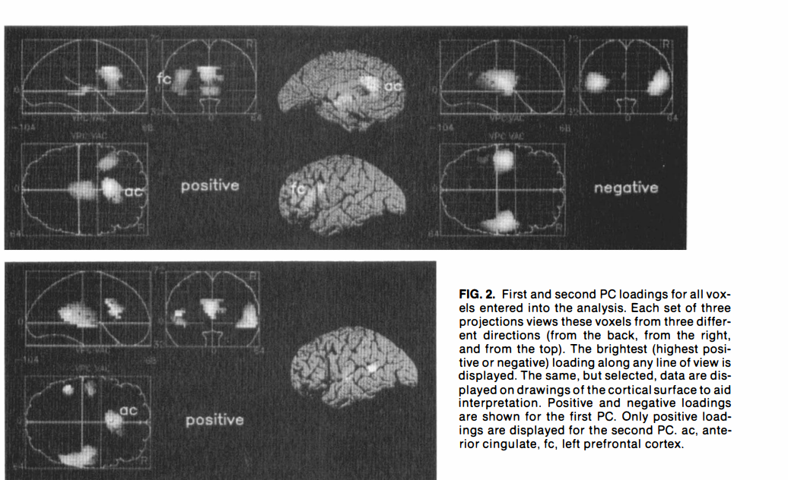

Slide 8
FUNCTIONAL CONNECTIVITY
high loading on the verbal fluency tasks and low scores on the baseline. Furthermore, these scores are largely invariant over time. The second PC had its highest positive loading in the anterior cingulate and appeared to correspond to a monotonic time effect with greatest prominence in the first three conditions (Fig. 4). It is interesting that the second PC included bitemporal regions, but on the left there was a selective involvement of Wernicke's area in the posterior superior temporal region (BA

Slide 9
DISCUSSION
Functional connectivity has been defined as the temporal correlation between neurophysiological (functional) measurements made in different brain areas. We have used a recursive PCA of such data obtained longitudinally from the same subjects with PET to demonstrate orthogonal (independent) functionally connected brain systems. The two systems evident in our data may represent an intentional system critical for the intrinsic generation of words and a second system whose physiology changes monotonically with time irrespective of the tasks the subject was engaged in. It is possible that this represents a more attentionally orientated system, which reflects the declining need for acquisition of perceptual set as the tasks become more familiar. The system corresponding to the first PC accounted for 71% of the observable differences in temarkable lltiusted mean rCBF from the 12 scans. This is a observation in that 71 % of the variance ill brain physiology was introduced by experimental _ign. This is a clear vindication of the PET techllique in the investigation of functional anatomy and oonnectivity. Furthermore, the distributed system wPlighted is in exact accord with that which has been predicted from anatomical connectivity. All of the components of this system (anterior cingulate, DLPFC, posterior cingulate, and superior temporal region) have dense and reciprocal connections (Goldman-Rakic, 1986, 1988).

Slide 10
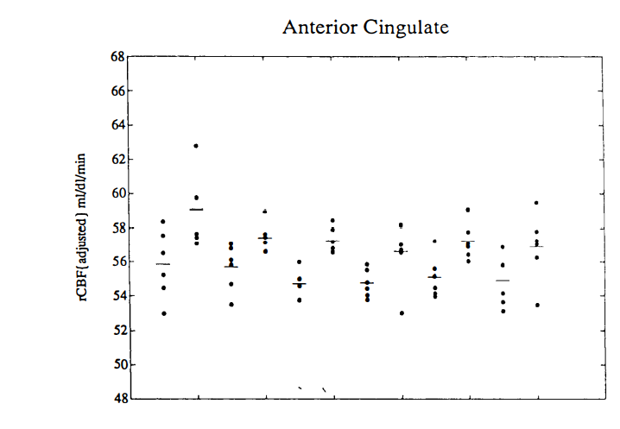

Slide 11
sembly" (Gerstein et aI., 1989) dynamics. Indeed, population thinking is central to some interpretations of neuronal correlations (e.g., Sporns et aI., 1989). A key difference between electrophysiological and PET indices of physiology is time scaling. This is important given the possible functional significance of high-frequency stimulus-specific oscillatory events in extended regions of visual cortex (Eckhorn et aI., 1988; Gray and Singer, 1989). Functional connectivity using the two techniques, however, can be linked at two levels: (i) A unifying concept is provided by coherence [u(w)]. Coherence is a measure of the correlation at a particular J Cereb Blood Flow Metab, Vol. 13, No.1, 1993 12 14 frequency (w) (Cox and Miller, 1980). Consequently, coherence and functional connectivity at a frequency w [fc(w)] are directly related: where gi/w) is the cross-spectral density and g;lw) and gjj(w) are the autospectral densities of the neurophysiological processes in question. Equation (4) explicitly relates functional connectivity to EEG coherence. Multielectrode recording and EEG measures deal with coherence at frequencies with periods of milliseconds whereas PET covers the lowfrequency component of the coherence profile on a

